Slide 1
Meeting Week 10
Last week summary
SVD: dimension reduction of the latent signals
Simulation
  LPV-LFR format
  Compare against frozen baseline
Question 1
Question 2
Outline ToDo next week

Slide 2
Last week summary
LPV in LFR format
M(Y) invertibility proven with Sylvester’s criterion
“Algebraic loop”
  Because of the invertibility of M(Y) not an algebraic loop

Slide 3
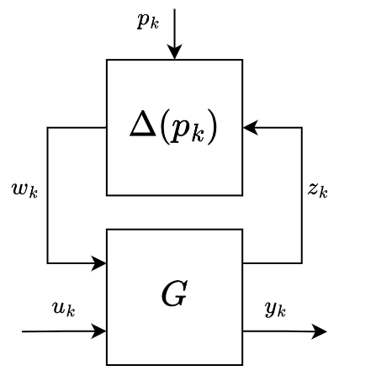
Last week summary
LPV in LFR format
M(Y) invertibility proven with Sylvester’s criterion
“Algebraic loop”
  Because of the invertibility of M(Y) not an algebraic loop
LPV model from García paper in LFR format

Slide 4
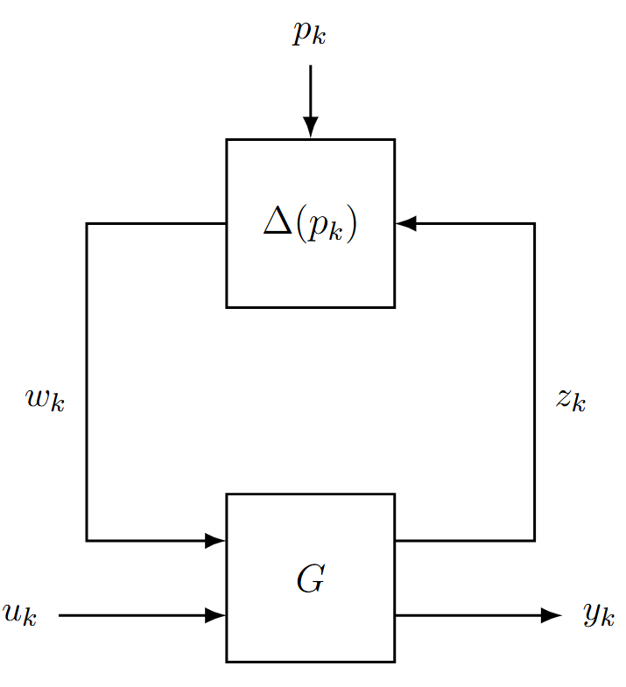
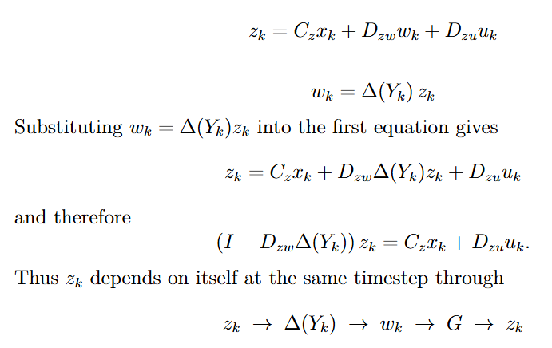
“Algebraic loop”

Slide 5
“Algebraic loop”
Because of the LFR-structure we have this loop structure
  G uses w
  Delta uses z
    No delay inbetween

Slide 6
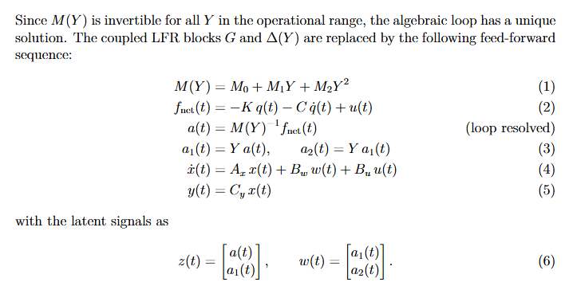
Elimination
Notes:
The LFR structure is preserved because z and w are assembled
and kept explicitly as tensors at the bottom.
Delayed was discussed with Roland but introduces errors
Elimination is mathematically correct but we sacrifice LFR structure

Slide 7
Elimination
Notes:
Use invertibility of M(Y)
The latent signals are dependent on this invertibility
The LFR structure is preserved because z and w are assembled
and kept explicitly as tensors at the bottom.

Slide 8
Elimination
Notes:
Use invertibility of M(Y)
The latent signals are dependent on this invertibility
The LFR structure is preserved because z and w are assembled
and kept explicitly as tensors at the bottom.
---------------------------------------------------
Roland discussed other method: online resolve
Is better at preserving LFR structure
(But for ease / wanting to implement in simulation went with Elimination method)

Slide 9
Elimination – Sacrifices separate Blocks
z and w can be reconstructed exactly after the loop has been resolved.
System is not executed as two separate runtime blocks G and Δ in feedback anymore.
  But the system still come from an exact LFR factorization, with valid latent signals z and w that satisfy the LFR equations.
At one sample k:
  G needs w
  Δ(Y) needs z
  But w = Δ(Y) z

Slide 10
Comment about Hysteresis
Tom suggested adding hysteresis to the baseline
  Sign of Y
Comment from Roland: good suggestion, but for the augmentation

Slide 11
LPV-LFR baseline - SVD
Current LPV-LFR minimal realization?
  Notes from Roland to reduce with SVD
Benefit of reducing latent channels:
  From 6 to 4 is minimal
  Less redundant internal variables → minimal structure
Replaced the 6-channel scheduling loop Δ(Y)=YI6 by an equivalent 4-channel loop Δ(Y)=YI4
Notes:
I don’t want to spend too much time on this, but in case I mention it in the future.
(→ I don’t want to go over the derivation)
Minimal structure but not more intuitive
What I did:
Dzw expressed as S2*P
Replace I6 by P
Construct Snew (compressed stacked matrix).

Slide 12
SVD - Numerical validation
Implemented the SVD-based reduction in MATLAB with the physical parameters of the dual-gantry system
Verified over operating range of Y
Used the Frobenius norm for validation

Slide 13
SVD - Numerical result
rank(Dzw) = 4 (expected 4)
rank(Snew) = 4 (expected 4)
Max ||A_coll - Ac||_F = 7.97e-13
Max ||B_coll - Bc||_F = 1.72e-16
The slightly larger error for A can be explained due to two matrix inversions (M(Y)^{-1}K and M(Y)^{-1}C). While B= [0;\ M(Y)^{-1}] only involves one.

Slide 14
Simulation – LPV-LFR baseline
LPV-LFR structure: compute x in logical coordinates [X, theta, Y]^T based on given input
Compare against MATLAB output
Metrics used

Slide 15
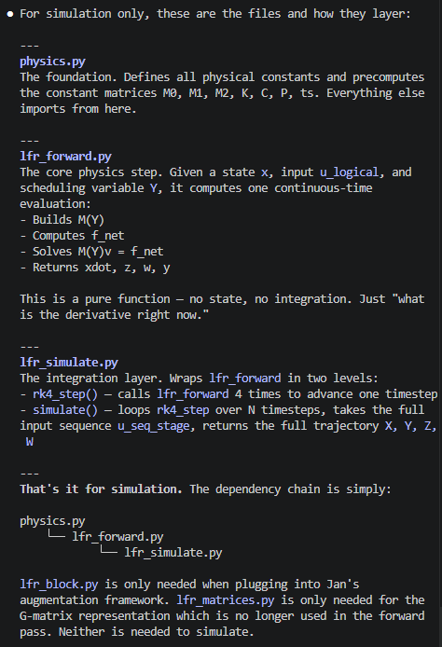

Slide 16
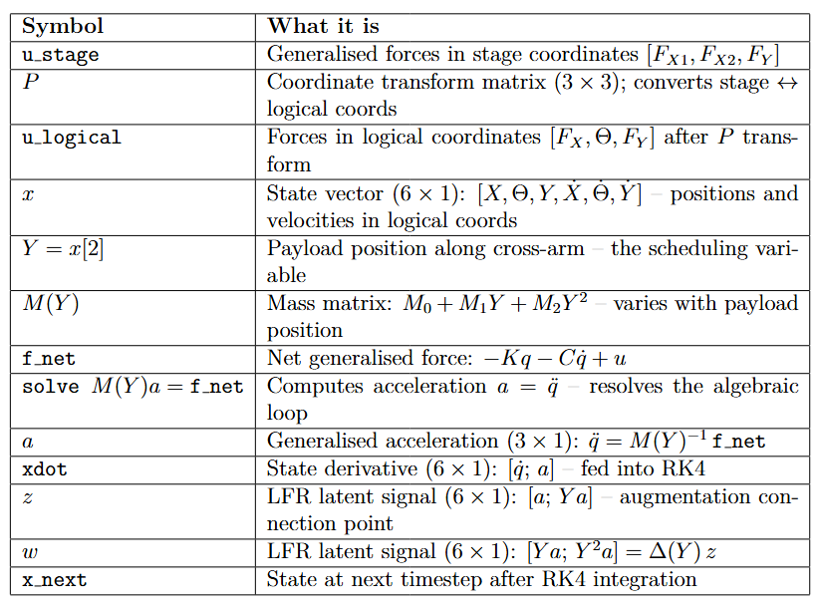
u_stage
P transform
u_logical
x (state, 6)
lfr_forward
Solve a = M(Y)^-1 f_net
← M(Y) = M0 + M1 Y + M2 Y^2
Y = x[2] (self-scheduling)
xdot
z
w
← z, w retained
[x 4 RK4 sub-steps]
x_next
Notes:
Our model is CT LPV-LFR use RK4 to discretize it
The forward solves the “algebraic loop”
Calculate 4 different x states, determine x_next based on that / discretization method

Slide 17
u_stage
P transform
u_logical
x (state, 6)
lfr_forward
Solve a = M(Y)^-1 f_net
← M(Y) = M0 + M1 Y + M2 Y^2
Y = x[2] (self-scheduling)
k1, z, w, y = lfr_forward(x, ...)
x2 = x + (ts / 2) * k1
k2, _, _, _ = lfr_forward(x2, ...)
x3 = x + (ts / 2) * k2
k3, _, _, _ = lfr_forward(x3, ...)
x4 = x + ts * k3
k4, _, _, _ = lfr_forward(x4, ...)
x_next = x + (ts / 6) * (k1 + 2 * k2 + 2 * k3 + k4)
xdot
z
w
← z, w retained
[x 4 RK4 sub-steps]
x_next
Notes:
Also worth noting for the diagram: z and w are only retained
from the k1 call (at the actual state x[k]). The other 3 calls
discard z, w (they get _). So the diagram should show z and w
branching off from k1 only.
- k1: at the current state x[k] — the start of the step
- k2: at x + (ts/2)·k1 — a half-step ahead using k1 as the slope
- k3: at x + (ts/2)·k2 — a half-step ahead using k2 as the slope
- k4: at x + ts·k3 — a full step ahead using k3 as the slope
So k2, k3, k4 are evaluated at temporary/intermediate states
that are never stored — they exist only to get a better estimate
of the average slope over the interval. Then all four slope
estimates are combined:
x_next = x + (ts/6) * (k1 + 2·k2 + 2·k3 + k4)

Slide 18
u_stage
P transform
u_logical
x (state, 6)
lfr_forward
Solve a = M(Y)^-1 f_net
← M(Y) = M0 + M1 Y + M2 Y^2
Y = x[2] (self-scheduling)
ts = 1/20000 = 50 μs, corresponding to fs = 20 kHz.
This matches the PLTI (Position Loop Time Interval) from the AccurET hardware specification.
k1, z, w, y = lfr_forward(x, ...)
x2 = x + (ts / 2) * k1
k2, _, _, _ = lfr_forward(x2, ...)
x3 = x + (ts / 2) * k2
k3, _, _, _ = lfr_forward(x3, ...)
x4 = x + ts * k3
k4, _, _, _ = lfr_forward(x4, ...)
x_next = x + (ts / 6) * (k1 + 2 * k2 + 2 * k3 + k4)
xdot
z
w
← z, w retained
[x 4 RK4 sub-steps]
x_next
Notes:
Z,w useful for augmentation, currently not used explicitly
Also worth noting for the diagram: z and w are only retained
from the k1 call (at the actual state x[k]). The other 3 calls
discard z, w (they get _). So the diagram should show z and w
branching off from k1 only.
- k1: at the current state x[k] — the start of the step
- k2: at x + (ts/2)·k1 — a half-step ahead using k1 as the slope
- k3: at x + (ts/2)·k2 — a half-step ahead using k2 as the slope
- k4: at x + ts·k3 — a full step ahead using k3 as the slope
So k2, k3, k4 are evaluated at temporary/intermediate states
that are never stored — they exist only to get a better estimate
of the average slope over the interval. Then all four slope
estimates are combined:
x_next = x + (ts/6) * (k1 + 2·k2 + 2·k3 + k4)

Slide 19
Discretization
CT model → RK4
  Compared to ODE45 sample time consistent
Input ZOH
  afd

Slide 20
3. The resolve-and-retain forward pass (1–2 slides)
The key design choice. Instead of collapsing to A_c(Y)x + B_c(Y)u, you solve
M(Y)v = f_net and keep z, w as explicit tensors. Why this matters: those
are the connection points where the augmentation attaches later.

Slide 21
4. Self-scheduling / quasi-LPV (1 slide)
Y is not an external signal — it's extracted from the state at every RK4
sub-step. Design choice: why re-extract at each sub-step rather than freeze
at the step start.

Slide 22
Simulation – RK4

Slide 23
Simulation – Validation
MATLAB output from q1 (Simulink model) vary Y between -0.3 to 0.3 m
  For the plant modeling in python, used u_q1 = C_fb(r − q1) as input to compare.
  Python in open loop; no feedback mechanism. Want to model the plant dynamics
  Used python for frozen baseline with same input u_q1, but Y is “frozen”
Compare LPV-LFR baseline and frozen (without Y-varying) baseline against MATLAB output u_q1
Notes:
The physics in q1 (gantrySystem.m) includes:
- Y-dependent inertia via M(Y)
- Viscous damping C
- Joint stiffness K
- No Coulomb friction
- No Coriolis/centripetal
Frozen baseline in python: Verified python against matlab couple meetings before.

Slide 24
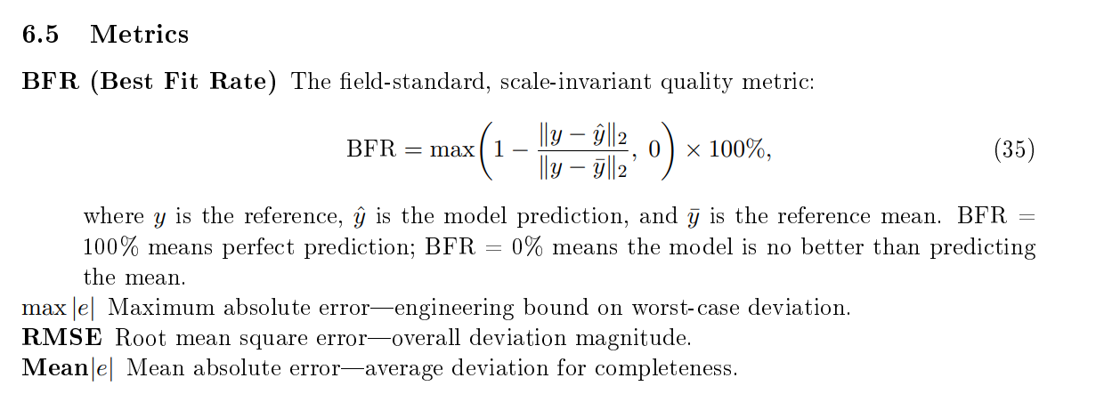
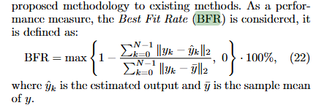
Simulation – Validation metrics
Best Fit Rate (BFR) (scale-invariant, how much better than just predicting the mean of the signal)
Root mean square error (RMSE)
Mean absolute error
Maximum absolute error

Slide 25
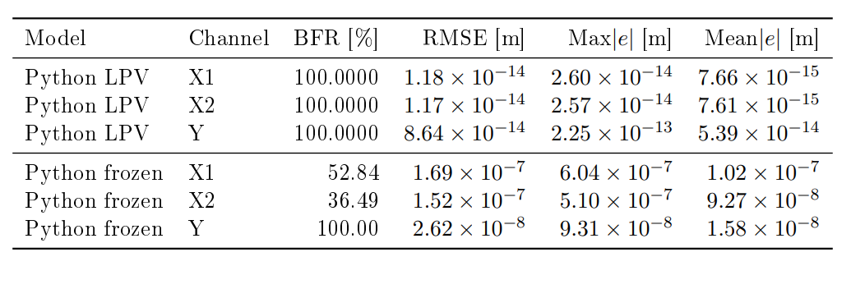
Validation results: Python LPV and frozen LTI vs MATLAB q1 reference. All models driven by u_q1 forces. Y range: -0.3 to +0.3 m.

Slide 26
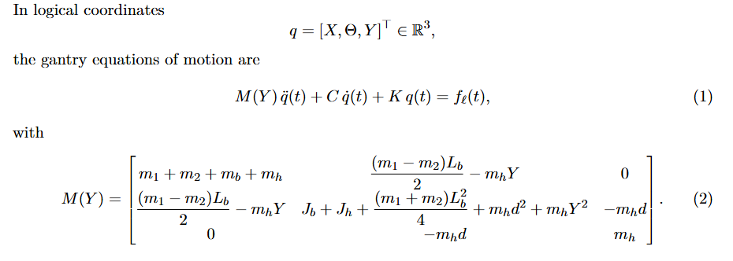
Python frozen high BFR for Y:
Y not expressed in Y
Rounding, with errors in the range of 10^-8: 99.999 circa 100%

Slide 27
Question 1
Which error is preferred: tracking error or settling error bound?
  In research plan mentioned health monitoring → would not be logical to focus purely on settling error
Settling error bounds: “These bounds indicate the maximum allowed deviation (after some settling time)”

Slide 28
Question 2
Controller & Feedforward
Worse controller performance is better for system identification:
  Leaves more informative excitation in the signals
What is the worst stable available controller available, or untuned controller without feedforward I could use?
  Can I access/export the controller for simulation used on the system?

Slide 29
Outline next week
Augmentation
  Parameter updating for the LPV-LFR baseline
  Baseline with additional states to validate augmentation (suggestion from Jasper)

